Slide 1

Managing the networks of the future
A step ahead
towards Data
driven Operations
BMAS Hackathon 3.0
Nov 22, 2019
Bangalore | Bucharest | Gwal Pahari | Noida

Slide 2
Agenda
BMAS Leadership Address
Enhanced Data Analytics - Journey
Data Driven Operations
BMAS Hackathon 3.0 - Statistics
10 Finalist teams
Final Winners announcement & Prize distribution
Organizing team Award
Closure Note

Slide 3
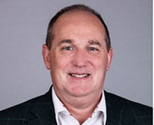
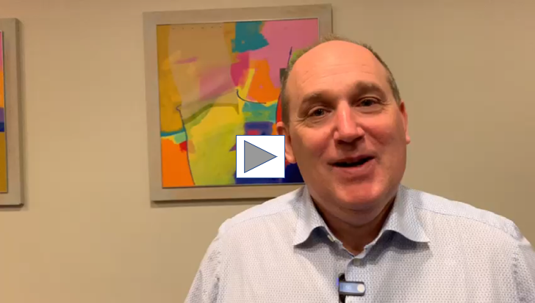
BMAS Leadership Address
Bradley Mead
Head of MS Networks

Slide 4
BMAS Leadership Address
Add content
Add Photo
Chris Neville

Slide 5
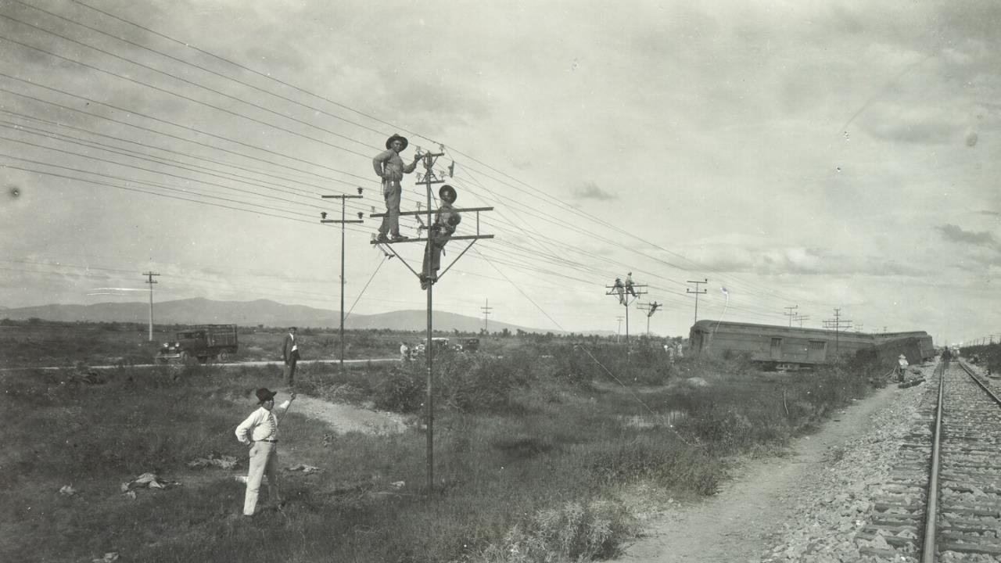
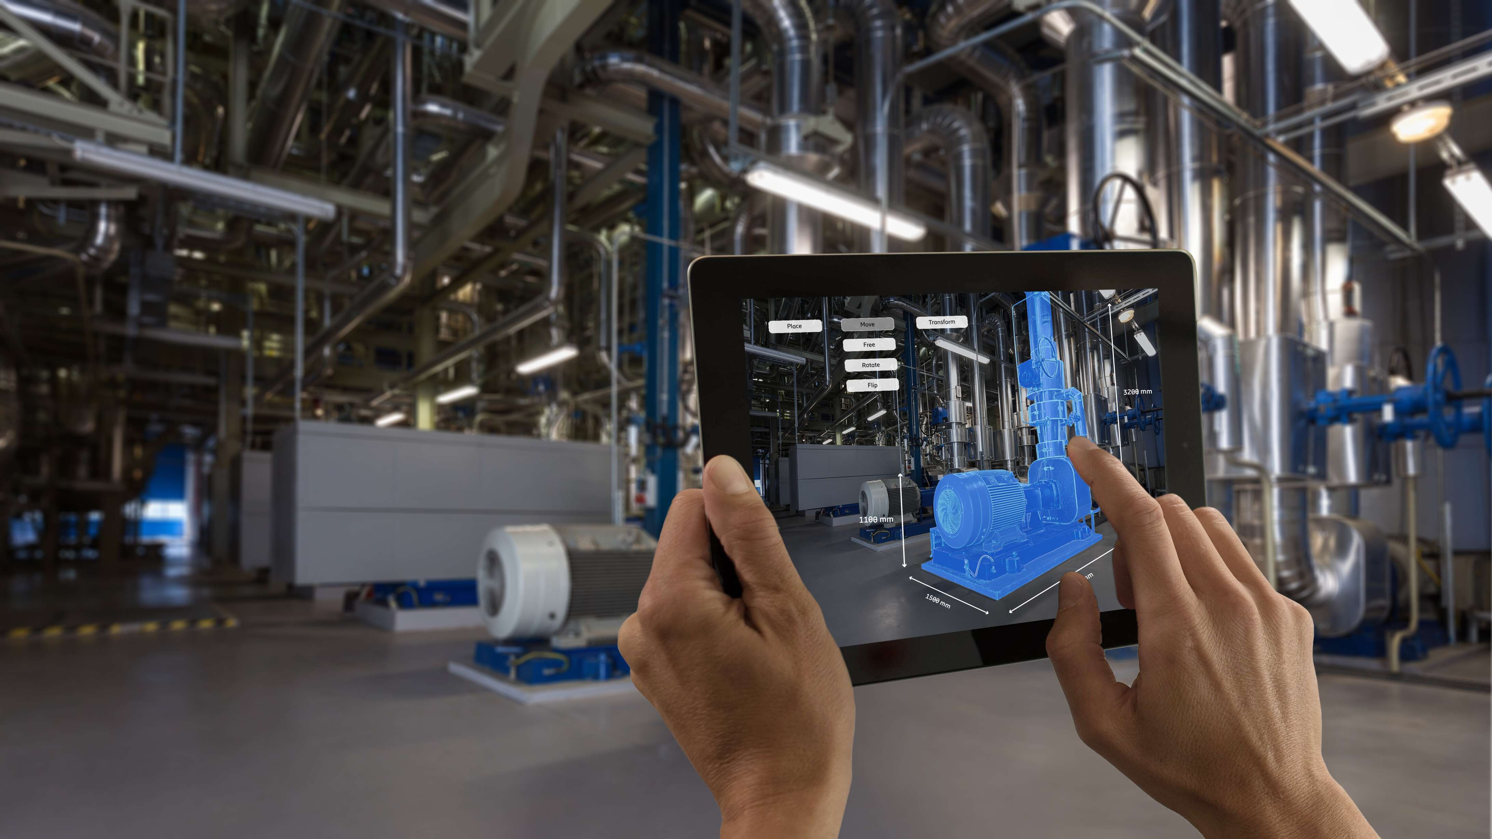

Enhanced Data Analytics - Journey From Normal Ops to AI/ML driven Operations
02+
Years of enabling data driven Operations
95%
Of the deliverables
are E2E
Automated
80+
MS Operations customers in 2019
10
Models in
Production from 2017 to 2019
Notes:
At Ericsson we long ago had the idea to make communications available for all – an idea that has changed the world.
We started out modest 140 years ago creating some of the worlds first phones. Still a revolution for its time.
Global standardization has allowed mobile technology to scale fast and gain scale quickly by bringing down costs for devices, making it possible for almost every person in the world to have access to communications today.
Devices are now being connected on a broad scale, 17.5 billion in 2017 and set to 31.4 billion by 2023. At the same time, the communication, the data traffic will eightfold.
Looking forward, at advanced artificial intelligence systems of the future, communication alongside computation will still remain critical.
For more than a century, telecom has been putting smart tools in the hands of smart people in every sector of our society and economy, and we are committed to continue to do so. We will enable intelligent connections to not just reach further than before, but to achieve the once unimaginable.
Ericsson predicts 1 billion 5G subscriptions in 2023
Nov 28, 2017 | General press release
5G will cover more than 20 percent of the global population six years from now, according to the latest Ericsson Mobility Report
Mobile data traffic continues to grow, primarily fueled by increased viewing of video content
LTE will be the dominant access technology by end of this year, driven by demand for improved user experience and faster networks

Slide 6
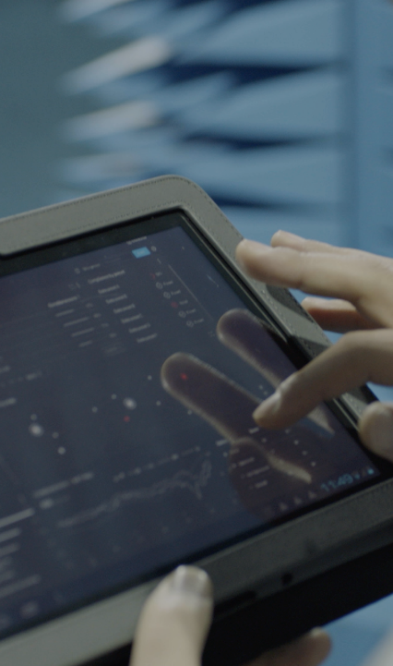

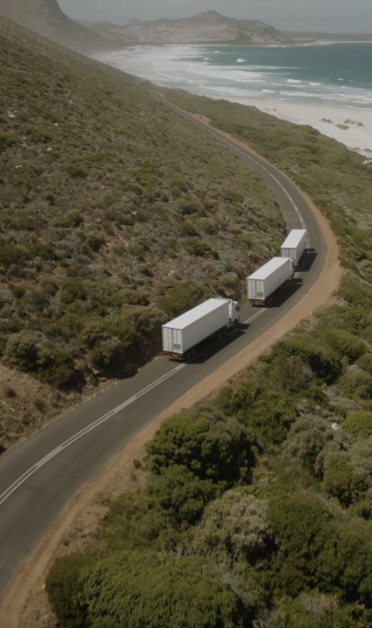
Three key requirements
Data Driven Operations
EOE
MINDSET
THINK BIG & DISRUPT
Notes:
Key message: The same feedback is consistent from all operators that there are at least three areas they need to succeed with:
Relentless efficiency – it is table stakes that the operators need to be more efficient, basically lower $ per Gigabyte.
E.g. Converging and radically simplified IT- & network environments, automation of operations
Customer experience – today’s customers expect a much more simple, flexible and faster experience. This is a key competitive advantage but often hard to do well due to complex legacy environments. The aim with digitalization is today often to facilitate empowered customers with personalized services and pro-active self-care, agile service creation and zero-touch automation from provisioning to assurance and insight based marketing & value growth
- E.g. Customer experience meeting or exceeding the bar set by today’s top digital retailer
New revenue streams – over the past few years growth has flattened out and traditional services do not generate the same returns as it once did. However, new usage related to IoT and industry digitalization in combination with network capabilities such as 5G open up new opportunities
- E.g. New services enabled by new network capabilities, e.g. network slicing and distributed cloud
Leverage technology advances – The winner in this highly competitive market will be the one that can best utilize the opportunities related to technology trends mentioned in the previous slide both for efficiency as well as for new services and revenues. The trends are related to AI, Automation, Cloud, Programmable networks and Full mobility.
Acronyms: VoLTE = Voice over LTE = Voice over Long Term Evolution. IoT = Internet of Things. EB = Exabyte
Customers looking to drive value creation in three key areas

Slide 7
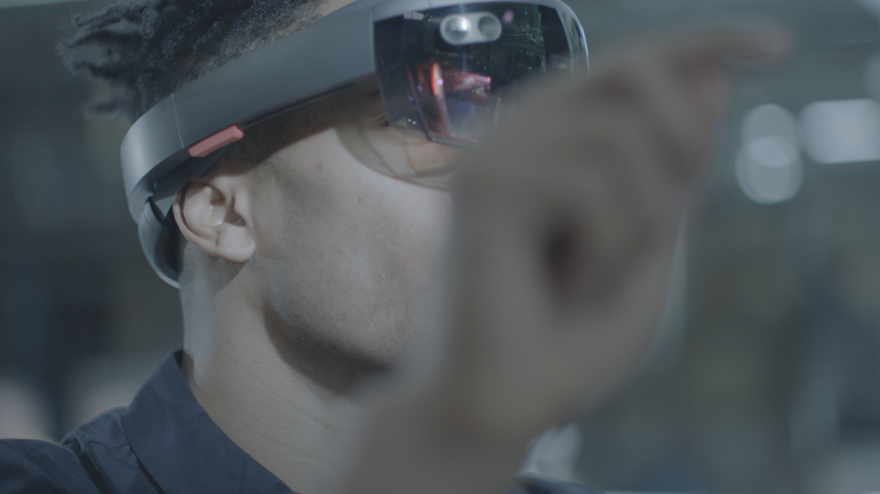

BMAS HACKATHON 3.0: A step Ahead towards data driven Operations
Numbers says it all!
15 Challenges
36 hours of fierce battle
130+ Teams registered
400+ Participants across the globe
800+ Gb Data crunched
80 Teams completed challenge on time
Notes:
WeEricsson has issued technology trends for some years now:
2015 https://www.ericsson.com/assets/local/publications/ericsson-technology-review/docs/2015/ericsson-technology-review-1-2015.pdf ,
2016 https://www.ericsson.com/assets/local/publications/ericsson-technology-review/docs/2016/ericsson-technology-review-2-2016.pdf ,
2017 https://www.ericsson.com/assets/local/publications/ericsson-technology-review/docs/2017/ericsson-technology-review_2017-technology_trends.pdf
The difference between 5G and the other Gs (2, 3, 4G) is that 5G will transform society and industry and is the enabler for the trends I see.
The first trend “An adaptable technology base” is the enabler for the entire technology stack

Slide 8


Slide 9
Awesome Contributions Time to recognize our people
10 Finalist teams
3 Winners
Awards

Slide 10

BMAS Hackathon 3.0 Awards – Nov’2019
Data Driven Operations
Driving Results
Prediction & Accuracy
Diversity
Business Value
Quest for Easy

Slide 11

BMAS Hackathon 3.0 – Finalists
10 Finalist teams
X (Simple table with Team name, Members and Unit)
Y
Z
10
Finalists

Slide 12
BMAS Hackathon 3.0 3rd prize
Some pictures to be added here
Team Name:
Team members:
Unit:
Problem Statement worked:
Summary –

Slide 13
BMAS Hackathon 3.0 2nd prize
Some pictures to be added here
Team Name:
Team members:
Unit:
Problem Statement worked:
Summary –

Slide 14
BMAS Hackathon 3.0 1st prize
Some pictures to be added here
Team Name:
Team members:
Unit:
Problem Statement worked:
Summary –

Slide 15
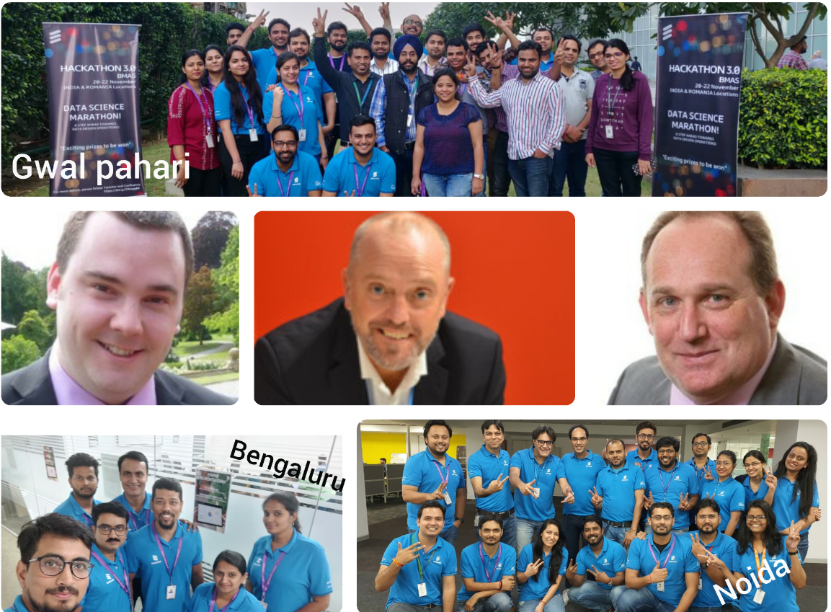
Organizers (Awesome Team!) Thanks for the Wonderful Event across BMAS
Enhanced Data Analytics (all locations)
Senior Leadership
Managers on the floor
Panelists
Communications
Facility
THANK YOU, all!

Slide 16

Congratulations all
& thank you
for you amazing contributions!

Slide 17
Thank you!

